Slide 1
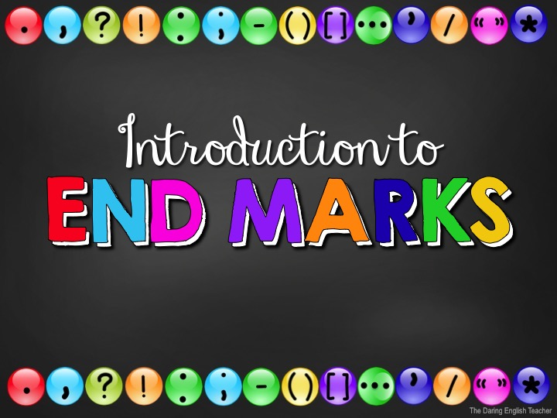

Slide 2
Punctuation
When we talk, we naturally pause and speak with intonation to communicate effectively.
When we write, we need to use punctuation to show these pauses and intonations.

Slide 3
Why Punctuate?
Using punctuation is important because it…
helps your writing flow.
increases the readers’ comprehension.
improves readability.
provides pauses.
conveys messages correctly.
If you punctuate incorrectly, you might write something with an entirely different meaning.

Slide 4
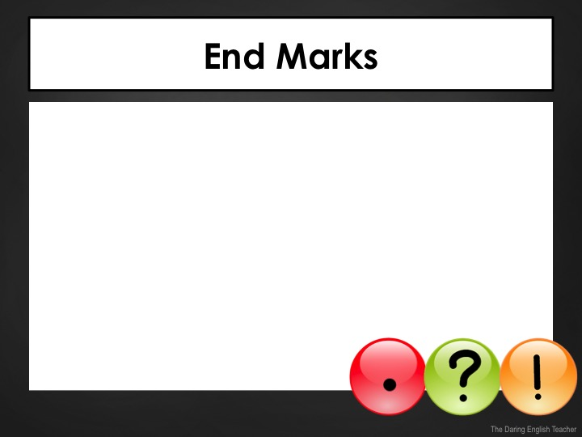
End Marks
What is an end mark?
An end mark is a punctuation mark that punctuates the end of a sentence.
Period
Question Mark
Exclamation Point

Slide 5
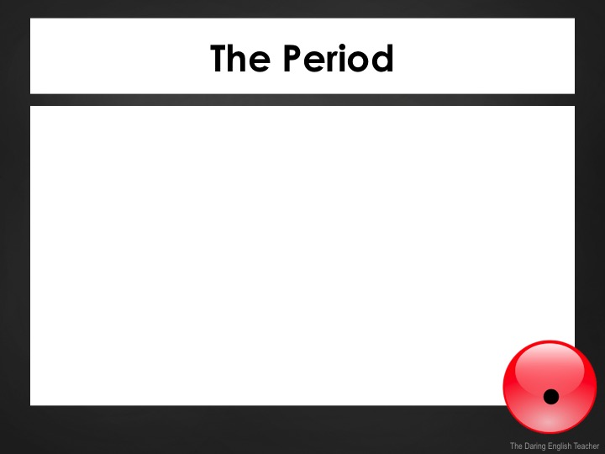
The Period
The period is a punctuation mark used at the end of a sentence or an abbreviation.
The period is also referred to as an end stop.
Example:
I went to the store.

Slide 6
The Period
Periods are also used in abbreviations.
Examples:
Dr.
Mr.
Mrs.
a.m.
Oct.
Mon.
*If a sentence ends with an abbreviation,
only use one period!

Slide 7
The Period with Quotation Marks
Periods should always be placed inside quotation marks.
Examples:
Gemma said, “I want to go to the park.”
Carlos replied to her and said, “that sounds fun.”

Slide 8
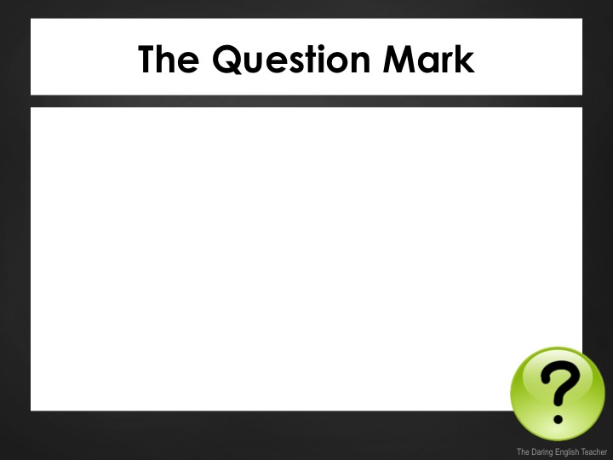
The Question Mark
The question mark is a punctuation mark used at the end of a sentence to indicate a question.
Examples:
Did you buy ice cream?
When do you want to go to the store?

Slide 9
The Question Mark
Do not punctuate an indirect question with a question mark. Even though it sounds like a question, it isn’t one. It is a statement.
Example:
I asked her if she bought ice cream.
Sam asked Sara if she had any lead.

Slide 10
The Question Mark with Quotation Marks
When writing with quotation marks, the sentence structure will determine where the question mark should be placed.
If the quote is a question, the question mark should go inside the quotation marks.
Examples:
He asked, “Did you buy ice cream?”
“Did you buy any ice cream?” he asked.

Slide 11
The Question Mark with Quotation Marks
If the entire sentence is a question, the question mark should be placed outside of the quotation marks.
Examples:
Did Mrs. Williams say, “there is no homework tonight”?
When did Jean say, “I dislike ice cream”?
Did Mom say, “don’t wash the dishes”?

Slide 12
The Question Mark with Quotation Marks
When writing with quotation marks, the sentence structure will determine where the question mark should be placed.
Examples:
He asked, “Did you buy ice cream?”
“Did you buy any ice cream?” he asked.

Slide 13
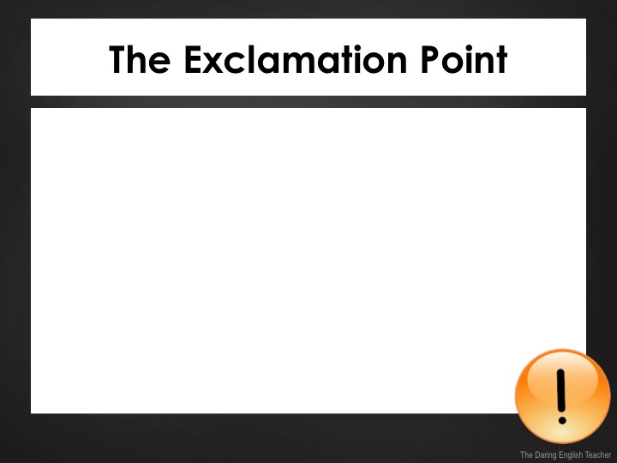
The Exclamation Point
The exclamation point is a punctuation mark used to indicate intense emotion.
It is used at the end of an interjection or a command.
Examples:
Don’t touch that!
Hey! Are you talking to me?
Wow! That is amazing.

Slide 14
End Marks Quiz
What end mark should you use?
Can we go to the park after dinner
?

Slide 15
End Marks Quiz
.
What end mark should you use?
She thought he asked about the car

Slide 16
End Marks Quiz
What end mark should you use?
What is going on over there
?

Slide 17
End Marks Quiz
What end mark should you use?
She wondered what was going on over there
.

Slide 18
End Marks Quiz
What end mark should you use?
I love spaghetti
!

Slide 19
End Marks Quiz
What end mark should you use?
In which chair are you sitting
?

Slide 20
End Marks Quiz
What end mark should you use?
No Don’t touch that
!
!

Slide 21
End Marks Quiz
.
What end mark should you use?
There are many paintings in the museum

